Slide 1
Sprint 4 - Presentation
By Joseph Colonna, John Costa, & Nicole Czerepak

Slide 2
Roles of Each Team Member
Nicole Czerepak
Owner of the robot
Writes Sphero block code
Tests code
Documents results of tests
Records sensor data graph
John Costa
Owner of GitHub repositories
Makes flowcharts
Writes System Design Documentation
Edits all materials
Joe Colonna
Writes algorithms
Makes and formats tables

Slide 3
Challenges We Faced
Doing a group project completely virtually for the first time
Had to create smaller scale courses due to space limitations
Using Sphero EDU
Robot was not always cooperative
Using GitHub
Writing System Design Documents

Slide 4
What Have We Learned?
How to work as a team virtually
How to use Sphero EDU and the robot
How to write algorithms and make flowcharts
How to write System Design Documents
How to use GitHub
How professional software engineers work

Slide 5
What Would We Do Differently?
Try to meet in person at least once
Plan ahead more
Ask more questions
Try to communicate more

Slide 6
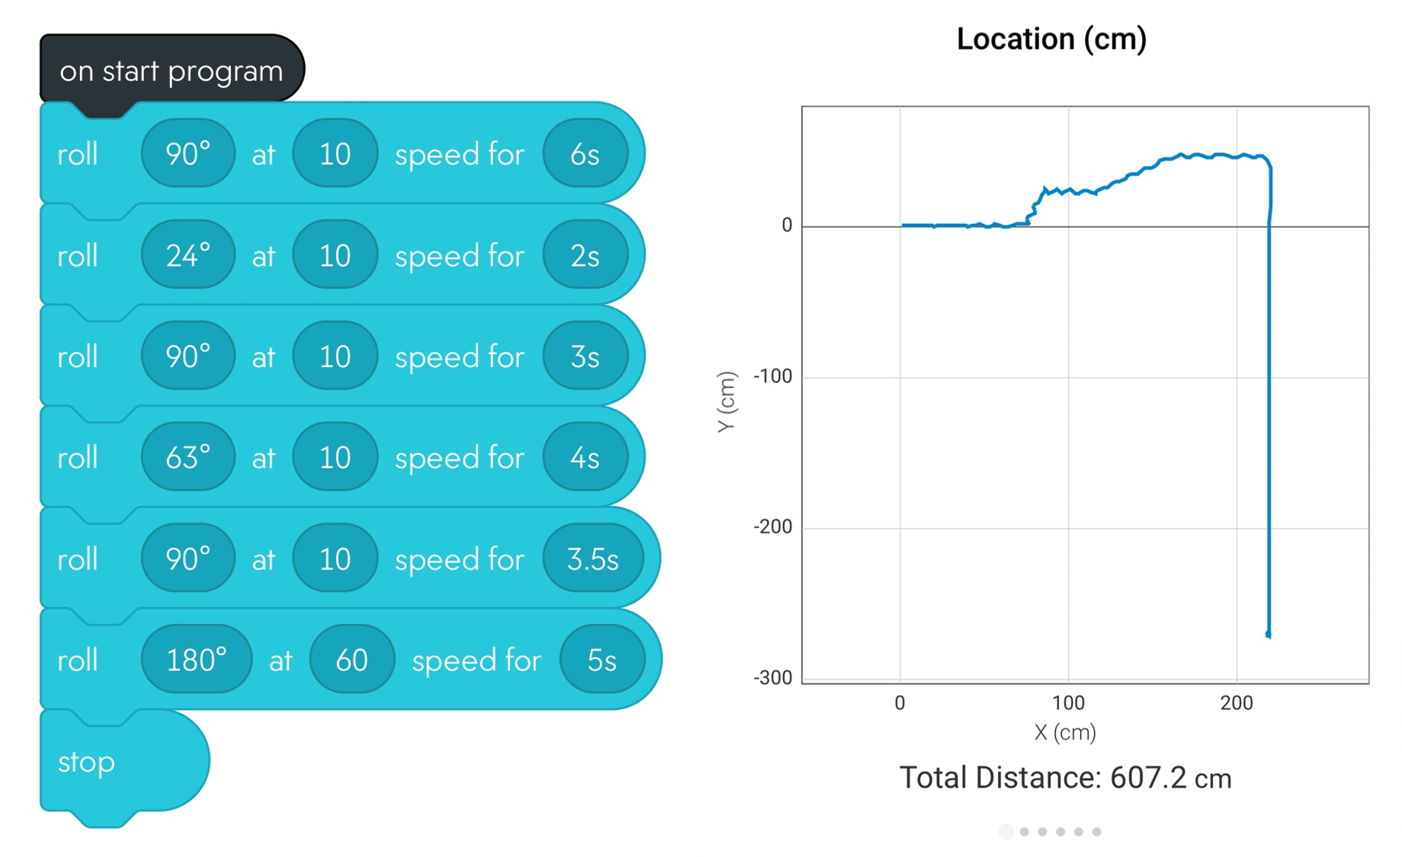
Sprint 3 - Agility
Block Code & Sensor Data

Slide 7
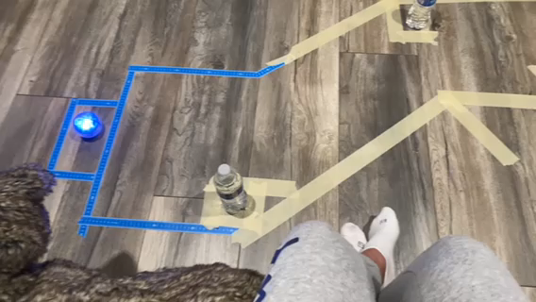
Sprint 3 - Agility
Video

